Slide 1
Grounds Maintenance
Market Engagement Event
3rd August 2026

Slide 2
Welcome
Thank you for attending the event
Introductions
Refreshments / Housekeeping
Opportunity for questions/feedback at the end of the presentation
Menti Quiz
Disclaimer – NIHE reserves the right to change the procurement strategy, process, timeline etc. at it’s discretion before tender is advertised.

Slide 3
Agenda
Grounds Maintenance Function Overview
Current Position
Current Grounds Maintenance Contract Lot Area Map
Grounds Maintenance Services Strategy
Scope of Work / Scale of Operation
Estimated Contract Lot Values
Payments and Contract Management KPI’s
Procurement Process
Procurement Strategy
Questions
Menti Quiz

Slide 4
Grounds Maintenance Function Overview
The Northern Ireland Housing Executive Grounds Maintenance function is a Regional based Client service providing a comprehensive Grounds Maintenance service to the Housing Areas across 3 Regions (Belfast, North and South).
NIHE is responsible for the maintenance of ‘soft’ open areas of grass, planted areas, hedges, trees, woodlands and ‘hard’ areas (incl. tarmac, concrete, pavior and cobbles).
The Grounds Maintenance function is currently split into 3x HE Direct lots and 6x Public lots. The lots vary in value, size and scope of works.

Slide 5
For the current contracts we:-
Separated Tree Surgery works into 5x Contract Lots
Upgraded from NEC3 to NEC4 Guidance
Moved to M3NHF Estates Services Specification and Schedule of Rates
Implemented a new suite of KPI’s
Adopted new Nature Positive elements – black top areas by non-chemical means

Slide 6
Current Position
The current CT085 Public Lots will expire on 31st October 2027
Belfast Region – Belfast North, West & Dairyfarm
Belfast Region – Belfast South, East, Lisburn & Castlereagh
North Region – East Area
South Region – North Down & Ards and South Down
South Region – South Area
South Region – South-West and Mid Ulster Areas
Please Note:– CT090 Tree Surgery Lots will expire on 30th April 2028. We propose a Market Engagement event in 2027.

Slide 7
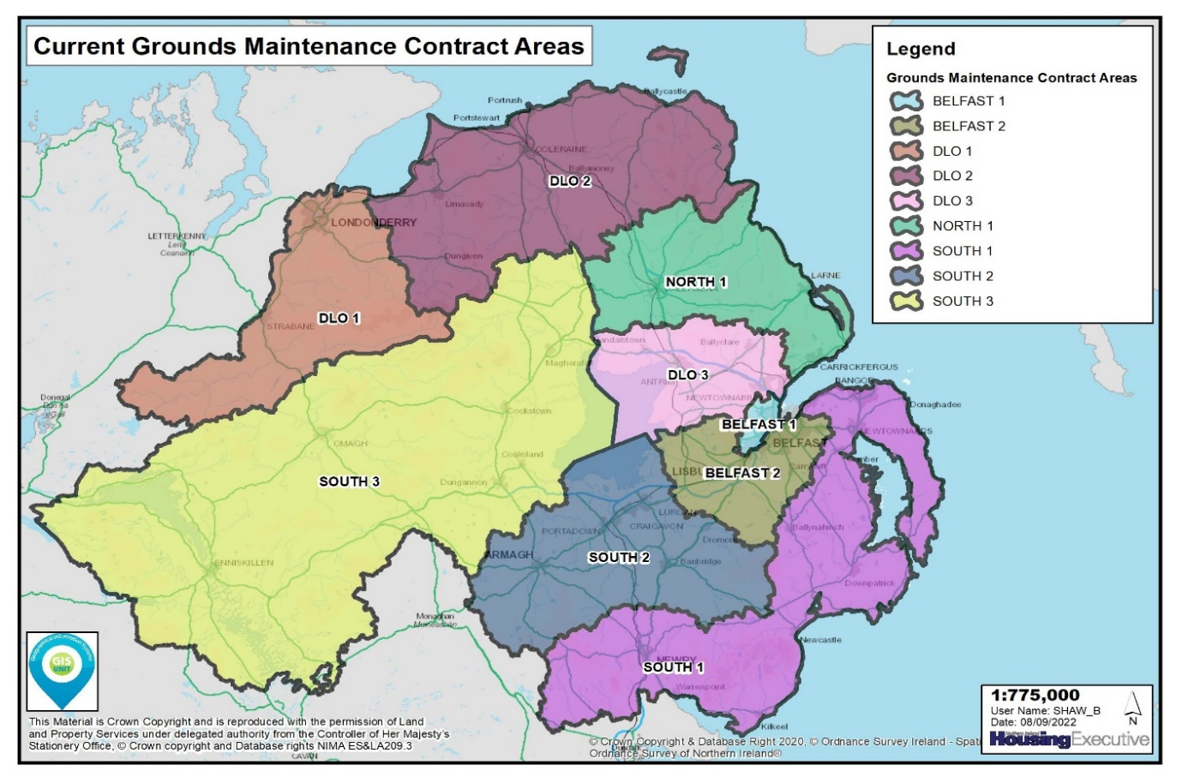

Slide 8
Grounds Maintenance Services Strategy
We aim to deliver a first-class Grounds Maintenance service:-
  6 Ground Maintenance Lots proposed.
  Length of Contracts: To be confirmed.
  The quantity of Lots a Supplier may win and any associated Conditions of Participation will be confirmed in the Tender Documents.
  New Nature Positive Strategy elements incorporated.

Slide 9
Scope of Work

Slide 10
Grass Areas–Formal, Informal, Rough, Wildflower
Herbaceous Borders
Hedges
Water courses and Culverts
Hard Surface Areas
Planted Amenity
Planted Woodlands
Features

Slide 11
Grass Cutting
Planted Woodlands
Hard Surface Areas
Litter Removal
Weed and Moss Control
Herbaceous Borders and Seasonal Bedding
Riverbeds and Culverts
Hedge Maintenance
Planned Works

Slide 12
Scheme Works
Shrub Trimming & Pruning
Bulk Rubbish/Fly Tipped Material Removal
Hard Landscaping
Planting of trees, whips, shrubs and hedges etc.
Any other response works
Bonfire Maintenance
Response Works

Slide 13
Scale of Operation

Slide 14
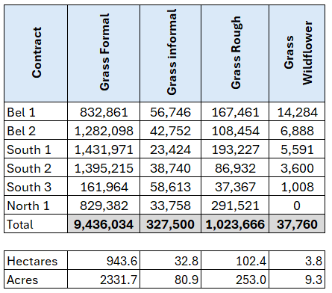
Scale of Operation (June 2026)
Grass Area

Slide 15
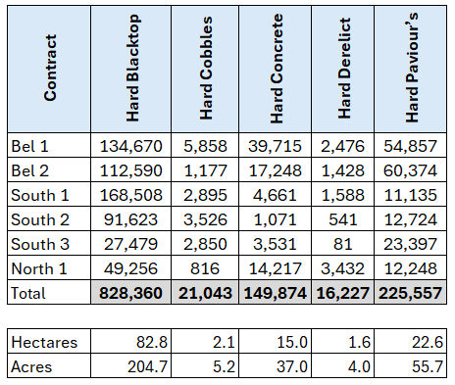
Scale of Operation (June 2026)
Hard Areas

Slide 16
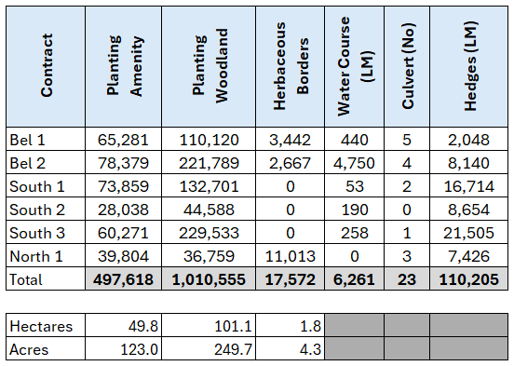
Scale of Operation (June 2026)
Others

Slide 17
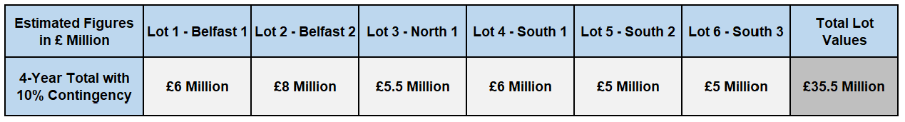
Estimated Contract Lot Values
These are estimated values only; which were created using:-
      Baseline – Estimated yearly spend on CT085 contract
      Estimated yearly uplifts for proposed 4-year contract term
      Proposed 10% contingency applied.

Slide 18
Payments
Payments are processed each month for Planned and Response works in line with NEC 4 contract payment processes.
Response payments are made monthly for works financially complete within that payment period.
Due to the seasonal nature of the Planned works, the payment process in the current contracts reflects the seasonal workload. Planned payments are being made in 24th’s of the overall annual value of the Planned works as set out in the table below:-
Month | Jan | Feb | Mar | Apr | May | Jun | Jul | Aug | Sep | Oct | Nov | Dec
24^{ths} | 1 | 1 | 2 | 2 | 3 | 3 | 3 | 3 | 2 | 2 | 1 | 1

Slide 19
Contract Management KPIs
The KPIs will cover the following themes:-
Quality of Service
Quality of inspection failures for Planned and Response works;
Time Predictability
Task orders completed on time; defect resolution for failed inspections etc. for Planned and Response works;
Social Value KPI
in accordance with Procurement Policy Note (PPN) 01/21 - (Social Value in Procurement)
Default Notices

Slide 20
Publishing Contract Performance Information
  Annual KPI Performance Reporting
    Applies to Public Contracts over £5m where KPIs are required
    Report against the 3 material KPIs
  Breach or Poor Performance Reporting
    Applies to most Public Contracts
    Relates to performance of entire contract, not just the 3 material KPIs
    Where a breach results in partial termination, award of damages or settlement agreement.
    Poor performance where the Supplier has been given an opportunity to improve but fails to do so

Slide 21
In Preparation for Bidding
System Registrations
You must register on both of the following platforms to participate in the competition:
  eTendersNI
  Find a Tender / Central Digital Platform
    You must also populate your Find a Tender account with your Supplier Information
How to register on Find a Tender: https://www.gov.uk/government/publications/procurement-act-2023-short-guides/suppliers-how-to-register-your-organisation-and-first-administrator-on-find-a-tender-in-three-easy-steps-html
You should also register with Constructionline to facilitate the Financial Capability Assessment.

Slide 22
Indicative Evaluation Model
Conditions of Participation
  Financial Capability: Constructionline Notation Value of a permitted Work Category at least equal to the threshold set in the PSQ1.
  Technical Ability: Provision of 2 contracts demonstrating previous experience satisfying the criteria set in the PSQ1.
Award Criteria
Proposed award criteria: 70% Price, 30% Quality (At least 10% of the award criteria will be allocated to Social Value)
Traditional written method statement responses are not expected to be used. Quality Evaluation expected to involve:
    Supplier Presentation 1: (Topic to be determined)
    Supplier Presentation 2: Social Value: How you will deliver the relevant initiatives within your Social Value Delivery Plan
    Social Value Deliver Plan: Submission by the Tender Submission Deadline

Slide 23
Indicative Timeline
Advertisement
12th February 2027
Tender Submission Deadline
Tender Evaluation Process
March / April 2027
June 2027
15th March 2027
Standstill Period & Award
Governance Approval
End of May 2027
Mobilization
1st November 2027
Contract Start Date (All Lots)
July, August, September & October

Slide 24
Any Questions?
The information contained within this presentation is indicative only and subject to change.

Slide 25
Market Feedback
Before we close the session, we want to hear from you.
Your operational expertise is beneficial to help us agree our lotting strategy, planned payment structure and our nature positive sustainability goals etc.
We will use Mentimeter to gather your feedback.
Your specific answers will not be linked to your company name so please be as candid and accurate as possible.

Slide 26
Go to the website menti.com
Enter the Code
Click Join
Only one person per company to answer questions

